Slide 1


AGE 316:
MICROCOMPUTER SYSTEMS
LECTURE 13: COMMUNICATION PROTOCOLS (I²C & SPI)
Dr. Kadeghe Fue
Department of Agricultural Engineering

Slide 2



Recap: How devices talk
Lecture 7: Serial (UART)
•
Uses 2 wires: TX and RX.
•
Asynchronous: No clock wire. Speed (Baud Rate) must be agreed upon.
•
Limitation: Can only connect 2 devices (1-to-1).

Slide 3







Concept: Synchronous Comm
To connect many devices efficiently, we use a Clock Line.
The Clock
Sync
Master/Slave
A wire that pulses ON/OFF regularly (like a metronome).
Data is sent only when the clock ticks. No need to guess the speed.
One boss (Arduino) controls the clock; everyone else listens.

Slide 4


Protocol 1: I²C
Inter-Integrated Circuit
Also known as "Two-Wire Interface" (TWI).
•
SDA (Serial Data): Data flows back and forth here.
•
SCL (Serial Clock): Keeps time.
Superpower: You can connect up to 127 devices using just these TWO wires!

Slide 5





How I²C Works: Addressing
If everyone shares the same wire, how do we know who is talking?
Every device has a unique HEX Address (e.g., 0x27 for LCD, 0x68 for RTC). The Master shouts "Hey 0x68!" and only that device replies.

Slide 6
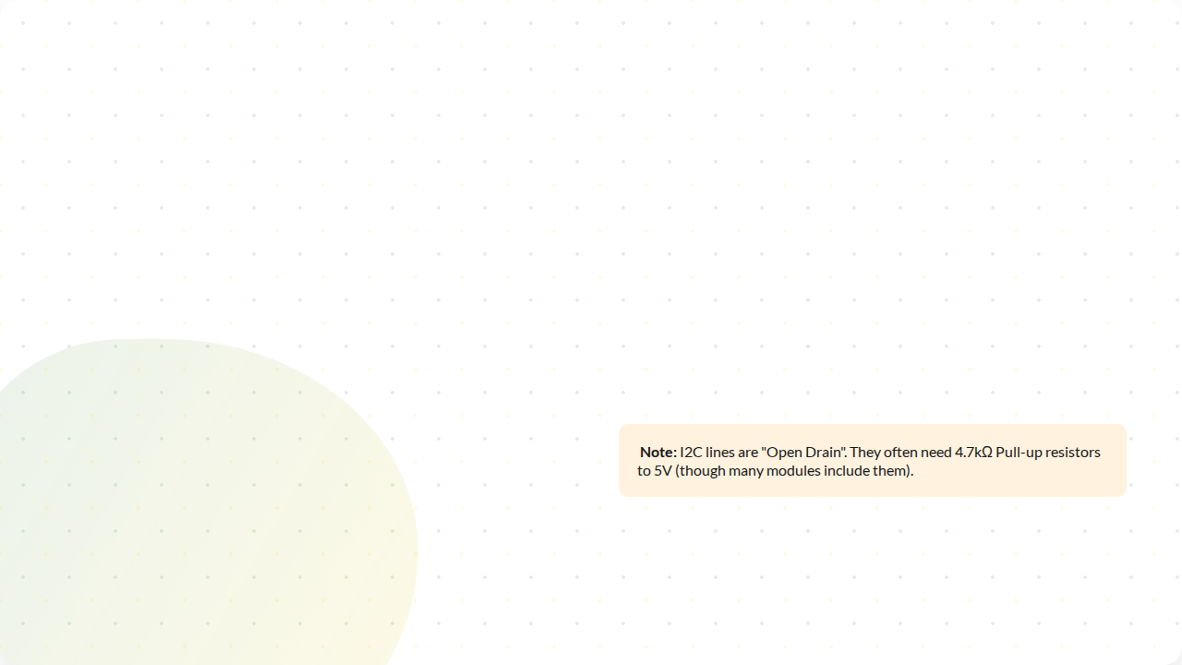
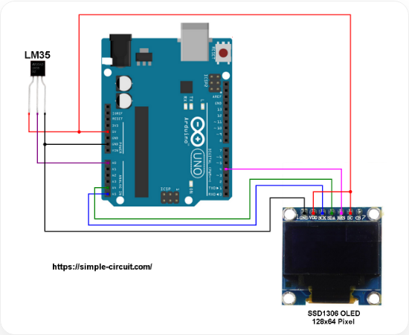
Wiring I²C
On Arduino Uno:
•
SDA: Analog Pin A4
•
SCL: Analog Pin A5

Slide 7

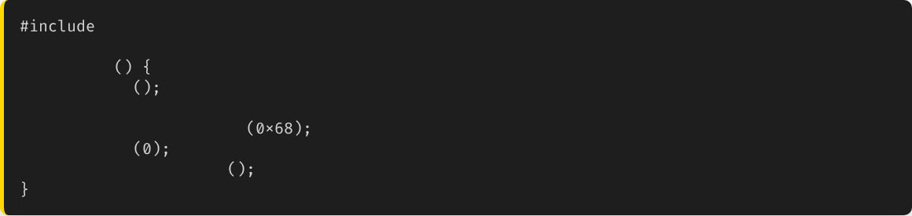
Code: The Wire Library
Arduino uses the Wire.h library for I2C.
void
setup
Wire.begin
// Join bus as Master
Wire.beginTransmission
// Talk to RTC
Wire.write
// Send data
Wire.endTransmission
// Stop

Slide 8

Protocol 2: SPI
Serial Peripheral Interface
Designed for SPEED.
Used for high-data devices like SD Card readers, TFT screens, and Cameras.
Very Fast
Trade-off: Uses 4 wires instead of 2.

Slide 9





Wiring SPI
MOSI
MISO
SCK
CS / SS
Master Out
Slave In
Master In
Slave Out
Serial
Clock
Chip
Select
Pin 11
Pin 12
Pin 13
Any Pin (10)

Slide 10

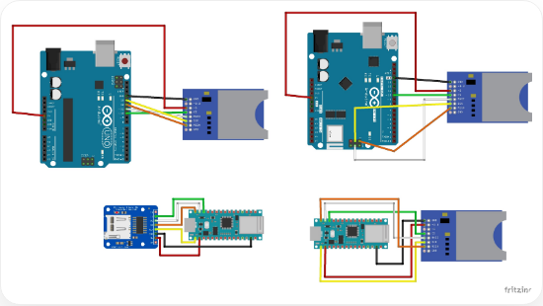
How SPI Works: Chip Select
SPI doesn't use addresses. It uses a dedicated wire for every slave.
•
To talk to Device A, Master pulls Device A's CS Pin LOW.
•
Device B ignores everything because its CS pin is HIGH.
•
Benefit: Extremely fast switching.
•
Drawback: More devices = More wires.

Slide 11

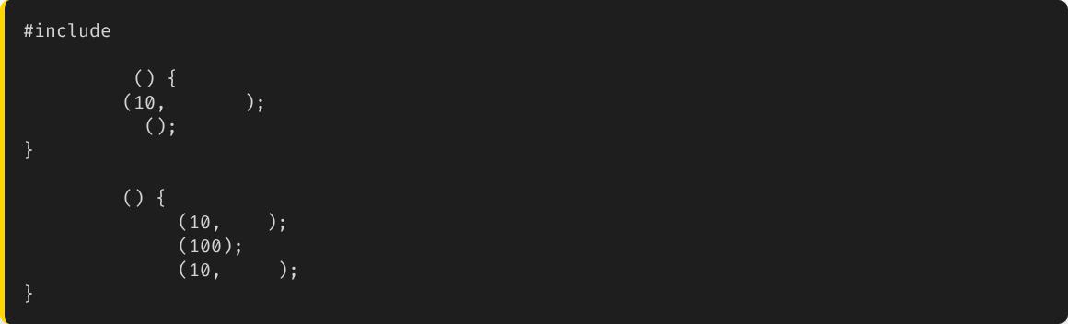
Code: The SPI Library
void
setup
pinMode
OUTPUT
// CS Pin
SPI.begin
void
loop
digitalWrite
LOW
// Wake up Slave
SPI.transfer
// Send data
digitalWrite
HIGH
// Sleep Slave

Slide 12

Comparison
Feature | UART (Serial) | I2C | SPI
Wires | 2 (TX, RX) | 2 (SDA, SCL) | 4 (MOSI, MISO, SCK, CS)
Speed | Slow | Medium | Very Fast
Devices | 1-to-1 | Up to 127 | Limited by Pins
Pros | Simple, Debugging | Saves Pins | High Speed

Slide 13




Applications in Agriculture
Sensors (I2C)
Data Logging (SPI)
Displays
Temp/Humidity (SHT31), Light (BH1750), Pressure (BMP280). Easy to daisy-chain.
SD Card Modules use SPI to write data fast enough so we don't lose readings.
OLEDs usually use I2C for simplicity.

Slide 14

Safety: Logic Levels
Warning
The Solution
Arduino Uno operates at 5V.
Many modern I2C/SPI sensors (like SD Cards) operate at 3.3V.
Use a Logic Level Converter (Bi-Directional).
Or check if your module has an onboard regulator (often looks like a small black chip).
Connecting 5V to a 3.3V device can destroy it instantly.

Slide 15






Summary
Synchronous
I2C
SPI
Uses a clock line to keep timing perfect.
2 Wires. Uses Addresses. Good for sensors.
4 Wires. Uses Chip Select. Good for SD Cards/Displays.

Slide 16


Lab Prep: Sensor Network
Next Lab:
We will connect an I2C LCD.
We will connect an I2C Temperature Sensor (e.g., BMP280).
We will display the temperature on the screen using the I2C bus.

Slide 17


Questions?
"The only stupid question is the one you don't ask."
Dr. Kadeghe Fue
Sokoine University of Agriculture

Slide 18



Image Sources
https://simple-circuit.com/wp-content/uploads/2019/03/arduino-lm35-ssd1306-i2c-oled-display.png
Source: simple-circuit.com
https://europe1.discourse-cdn.com/arduino/original/4X/d/8/b/d8beb8852e8bab43cbdf409c4c7ed177eaee53d0.jpeg
Source: forum.arduino.cc

